Slide 1
THE STIGLITZ-SEN-FITOUSSI Report.
Towards a statistical revolution ?
Frédéric Lebaron
(CURAPP UPJV-CNRS)
Seminar at the Higher School of Economics
26 October 2010

Slide 2
Introduction
What is the “Commission on the measurement of economic performance and social progress” ? A commission composed of 25 high-level international researchers (inc. 5 “Nobel economists”, OECD and UNDP experts) appointed in February 2008 by the French president : propose new ways of measuring economic performance and wealth, social progress, environmental destructions.
Website of the Commission: http://www.stiglitz-sen-fitoussi.fr/en/index.htm
Two books published in French in november 2009.

Slide 3
Introduction
A strong scientific, political and mediatic event in September 2009:
“My deep conviction is that if we don’t change the measure of our performance, we won’t change our behaviour. (...) We have to change the criteria of our social organizations and public policies. (...). Behind the religion of figure (...), there is also the religion of the never failing market. If the market had an answer to everything, we would see it, if he was never failing, it would be known.” (Nicolas Sarkozy, preface, p.21).

Slide 4
Introduction
The measurement of performance and well-being is challenged in times of crisis: more than a coincidence. Vanishing faith in current evaluation of performance (especially when it is based on market value).

Slide 5
Introduction
The consecration of a long-term process towards the legitimization of new indicators of whealth, happiness, social health, quality of life, etc.
Various labels and indicators have flourished since the 1990s: “Human development” (UNDP), “social capital”, “quality of growth” (World Bank), “social indicators” (OECD), “social health”, “economic well-being”, “barometer of inequalities and pauverty” (RAI, France), etc.
A variety of initiatives, institutions, groups, experts, disciplines.

Slide 6
A few research questions
Will this report represent an important shift in the history of socioeconomic statistics ?
What kind of changes can it impulse, first in socioeconomic statistics, but also in social organizations and in the field of public policies as claimed by the French President ?
What were (are) the reception and the first followings of the report in France and more largely (Europe, OECD, World) ?

Slide 7
Organisation of the talk
1. A revolution in national accounts production and diffusion ? Classical and new critiques of GDP, alternative measurements.
2. How to grasp the multidimensionality of “quality of life” and “well-being” ? Theoretical and methodological debates.
3. How to integrate environmental degradation in usual measurements ?
4. Some first consequences of the report.
5. A cognitive shift ?

Slide 8
1. A revolution in national accounts ?
A synthesis of some largely debated critiques of GDP since the 1970s (Tobin, Nordhaus and many others):
= market-centred (e.g. non-market public services badly evaluated on the basis of their costs and not their outputs) ;
includes “defensive” expenditures (like prisons, restauration of the environment, etc.) which should not be taken as positive contributions to value ;

Slide 9
1. A revolution in national accounts ?
includes profits made by foreign firms reinvested abroad and diverges with net income ;
Does not include a large part of household production (cf. the feminist critique, sometimes evaluated around one third of GDP) ;
Does not include the depreciation of equipments (“gross” not “net” measure).
Does not show the variations of the stock of wealth. A flow measurement.

Slide 10
1. A revolution in national accounts ?
Leads to clear recommendations:
Adopt a household, consumption and income-centred approach of national accounts;
Consider wealth and not only income (balance sheets of nations).
Prefer the median to the mean as a statistical summary for a distribution, and use more dispersion (inequality) indexes.
For non-market services, at least a neutrality principle as regards the juridical status (public or private) of production units;
Concretely, complement the use of GDP with other national accounts avalaible indicators like Net Domestic Product (depreciation of equipments) ; Net Disposable Income ; Adjusted Net Disposable Income (adding imputations).

Slide 11
1. A revolution in national accounts ?
Debates and reactions (in France):
Support of the GDP as a relevant measure of market conjonctural activity (among Neoliberal, Keynesian or Marxist economists) and strong inertia of practices (see recent McKinsey report Beyond austerity: A path to economic growth and renewal in Europe);
Complex and highly conventional practical consequences (like the development of“imputations”, i.e. fictive prices in the absence of evaluation by the market);
Limited consequences of the changes (e.g. for international rankings);

Slide 12
2. How to grasp the multidimensionality of “quality of life” and well-being ?
Quality of life: non monetary dimensions of social progress. Multiplicity of dimensions.
Three main theoretical frameworks: subjective well-being (post-utilitarian) / capabilities (objective bases of freedom) / equitable allocation (combine various subjective weights).
Subjective and objective dimensions of the quality of life: which indicators are the most appropriate ? The answer of the CMPEPS is: both sorts.

Slide 13
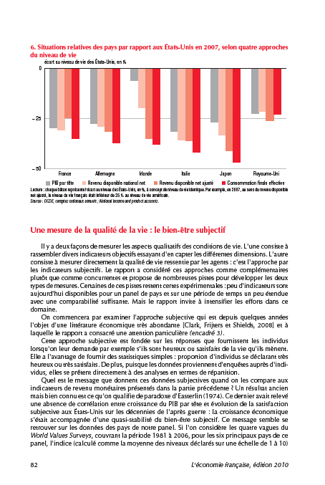

Slide 14
2. How to grasp the multidimensionality of “quality of life” and well-being ?
Combine various indicators of living conditions (other than income-wealth-consumption):
Health : demographic indicators, self declared health. The most solid data.
Education (human capital, but also its specific impact on quality of life): school enrolment, evaluation of the competences (PISA-style).
Personal activities (including work, leisure, travel, etc.): time-budgets, time uses and perception.

Slide 15
2. How to grasp the multidimensionality of “quality of life” and well-being ?
Political representation and governance: free, fair, regular elections, etc. Codings.
Social ties : membership to organizations, altruist behaviour... Still very discussed indicators.
Environmental conditions: air, water pollution, catastrophies which directly impact actual well-being.
Security (physical and economic) : victimation surveys, employment protections, social safetynet.

Slide 16
2. How to grasp the multidimensionality of “quality of life” and well-being ?
Conventions are as important as in national accounts, but the consensus is still far weaker. Competing indicators for each dimension.
Absence of standardization of statistical information for most of them (accross nations and time).
How to hierarchize or weight the different dimensions of well-being ?

Slide 17
2. How to grasp the multidimensionality of “quality of life” and well-being ?
The question of agregation and synthetic indicators: a critical point of view of the commission. Again, how to weight the dimensions ?
The need for more subjective indicators (“U-index”, Kahneman, Krueger).
The importance of dispersion measures and not only means. Inequalities for each dimension.
A set of moderate recommendations. Need for new survey data.

Slide 18
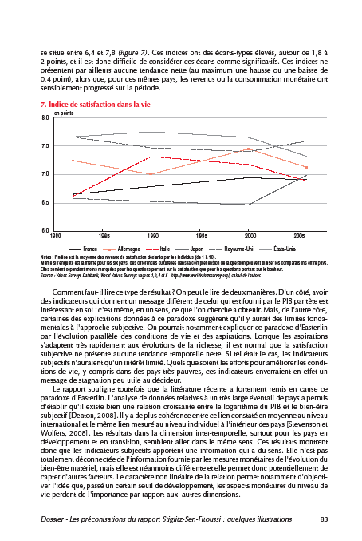

Slide 19
3. How to integrate environmental degradation in our common measures ?
The need to distinguish between instantaneous well-being and its « durability » or sustainability. Diminishing or vanishing physical or human resources may condemn future well-being.
Dashboards or composite indexes ? Limited number at least.
Monetary or physical indexes ? A remaining stake.
Instanteneous measures and the well-being of future generations are two different things: flows and stocks. Some « green » indices (green GDP, adjusted GDP...) do not define sustainability. Need for projections and in monetary indexes, for prices. Sometimes very artificial (e.g. In case of depletion of some resources).

Slide 20
3. How to integrate environmental degradation in our common measures ?
Need for indexes of overconsumption and underinvestment => Net Adjusted Saving (WB, Arrow), Environmental Footprint (WWF, etc.).
How to construct a unique index of sustainability ? Use of fictive prices for all sorts of capital (economic, human, physical), define a “level” of sustainability (national / international), monetary or not: highly conventional hypotheses.
A very technical and not consensual program. A large research-field for economists and statisticians.

Slide 21
4. Institutional consequences of the report.
A strong impulse for public statistics: INSEE, Eurostat, OECD. Changes are slowly under way.
Relative marginalization of NGOs and independent research institutes from the public debate. Domination of economic experts.
The monetary estimation of environmental degradation is now officialized (Nagoya UN confer.
Towards a general debate on public policy indicators ? Would imply a democratic mobilization of citizens.

Slide 23
5. The space of reactions: a cognitive shift ?
A ponctual mediatic and political stake: no strong opposition, but a politicized reception in France.
Economic experts and the report: critical support among the French promotors of new indicators of wealth (like Jean Gadrey, “anti-growth” economist) ; few enthusiasm or even silence among leading economists (out of OFCE and INSEE) ; no strong rejection in general.
“Profane” reactions: politicized and often skeptical, sometimes enthusiastic. Role of the citizens ?

Slide 24
Conclusion
A challenging report, which should be largely debated in all the countries and followed by “new practices” in socioeconomic statistics.
Implies heavy public investments in survey research and methodology, in times of “austerity”, domination of budget constraints and purely “accounting” criteria of performance. A paradoxical situation.
Could lead in the mid-term to new public policies, more clearly focused on social and environmental objectives and less on market-based performance.

Slide 25
Thanks for your attention !

