Slide 1
How Systems Improve:
A Constellation of Forces
Michael Fullan
February,2014
Moscow

Slide 2
Recent Publications
Hargreaves and Fullan, Professional Capital
Fullan, Stratosphere: Integrating, Technology, Pedagogy, and Change Knowledge
Fullan, The Principal: Three Keys to Maximizing Impact (Jan, 2014)
Fullan and Donnelly, Alive in the Swamp (2013)
Fullan and Langworthy, A Rich Seam: How New Pedagogies Find Deep Learning (see michaelfullan.ca))

Slide 3
Getting Accountability Right
Cultivating
systemness
How Systems Improve: A Constellation of Forces
Relentless High Expectations
Capacity Building Plus Plus
Learning From Implementation
Policies & Strategies
Fullan, 2014

Slide 4
Relentless High Expectations
That challenge the status quo.

Slide 5
Cultivating ‘Systemness:
Partnership with the sector, establishing commonly owned strategy in the system as a whole.

Slide 6
Get Accountability Right
Overall Developmental Stance/Culture of Learning
Focus on Capacity Building
Transparency
Monitor Progress and take Developmental Action
Intervene Selectively

Slide 7
Capacity Building
Associated with degrees of school/district autonomy under the following conditions:
Focusing on powerful pedagogies linked to deep student learning
Transparency of results and practice
Principal and teacher collective participation in instruction
Purposeful collaboration with other schools/district
Shared standards, metrics and evidence re progress
Establishing processes that ‘systematize the work’
Mutual commitment to combine internal and external accountability

Slide 8
Establishing Policies and Strategies
To integrate human and social capital including developing the teaching profession and leaders at all levels.

Slide 9
Learning From and Acting On:
Evidence from implementation, locally and globally.

Slide 10
Leadership and Change

Slide 11
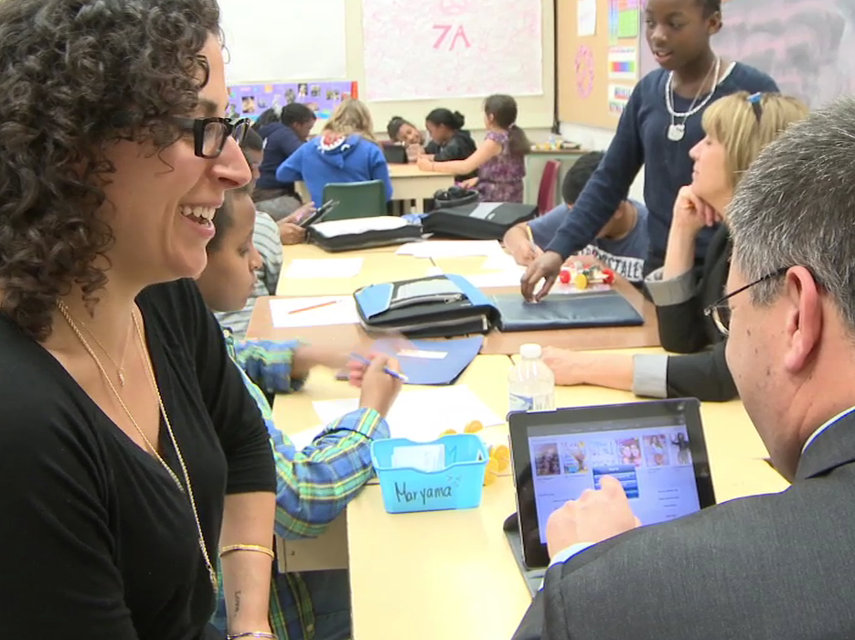
Good Accountability
Is a function of good data, used as a strategy for improvementRequires non-judgmentalismDepends on widespread transparencyProduces strong ‘internal accountability’ which in turn produces strong public accountabilityFuses assessment and instruction

Slide 12
Capacity Building
Focus on the development of individual and collective competencies essential for improvement at school and district levels.

Slide 13
Professional Cultures

Slide 14
PROFESSIONAL CAPITAL
Human Capital
Social Capital
Decisional Capital

Slide 15
The Principal’s New Role
Leading Learning
System Player
Agent of Change
One who moves people and
organizations forward
under difficult circumstances.
One who contributes
to and benefits from the increased performance of the others schools in the district and of the system as a whole.
One models learning and develops collaboration.

Slide 16
Human Capital
Human capital refers to the human resources or personnel dimension of the quality of the teachers in the school-their basic teaching talents.

Slide 17
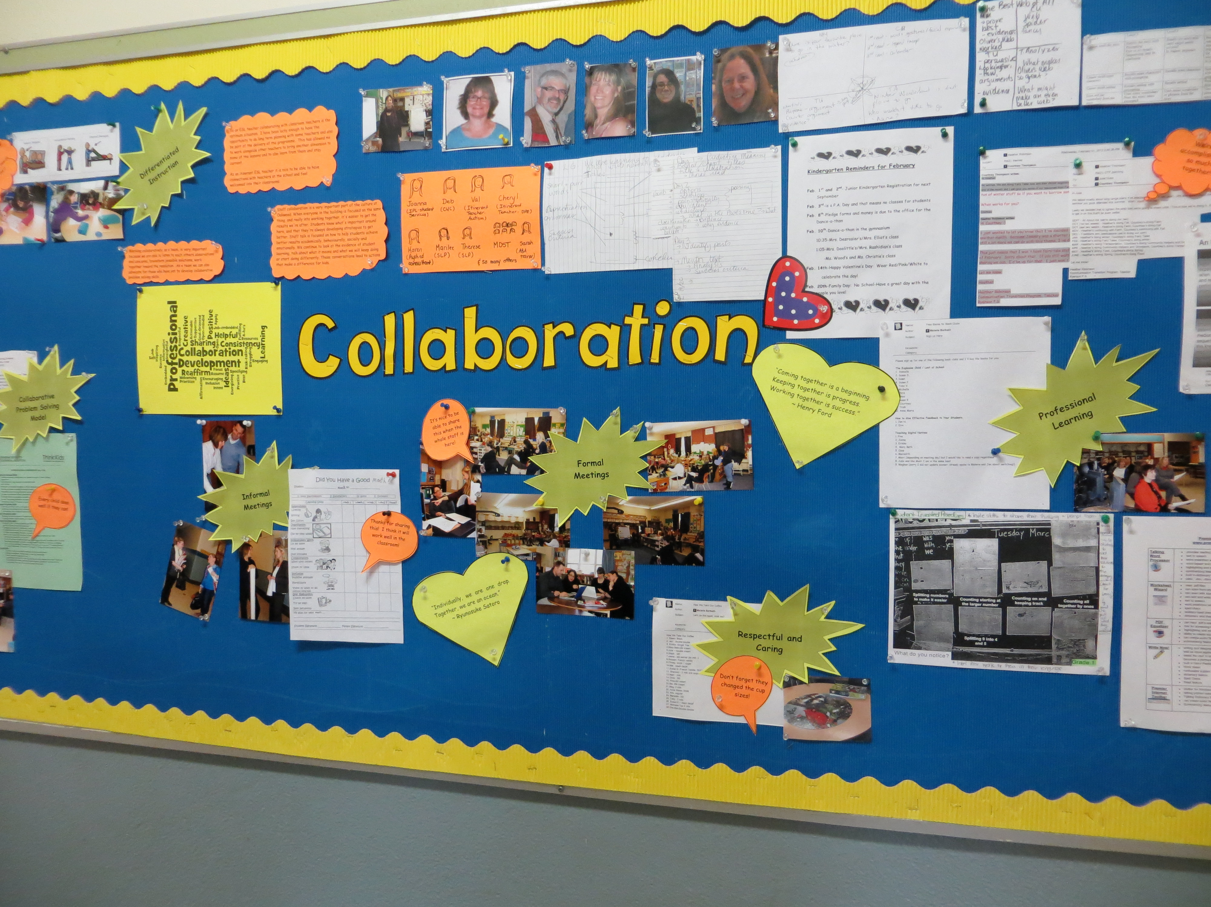
Social Capital
Social capital concerns the quality and quantity of interactions and relationships among people. In a school, it affects teachers’ access to knowledge, and information, their sense of expectation, obligation and trust; and their commitment to work together for a common cause.

Slide 18
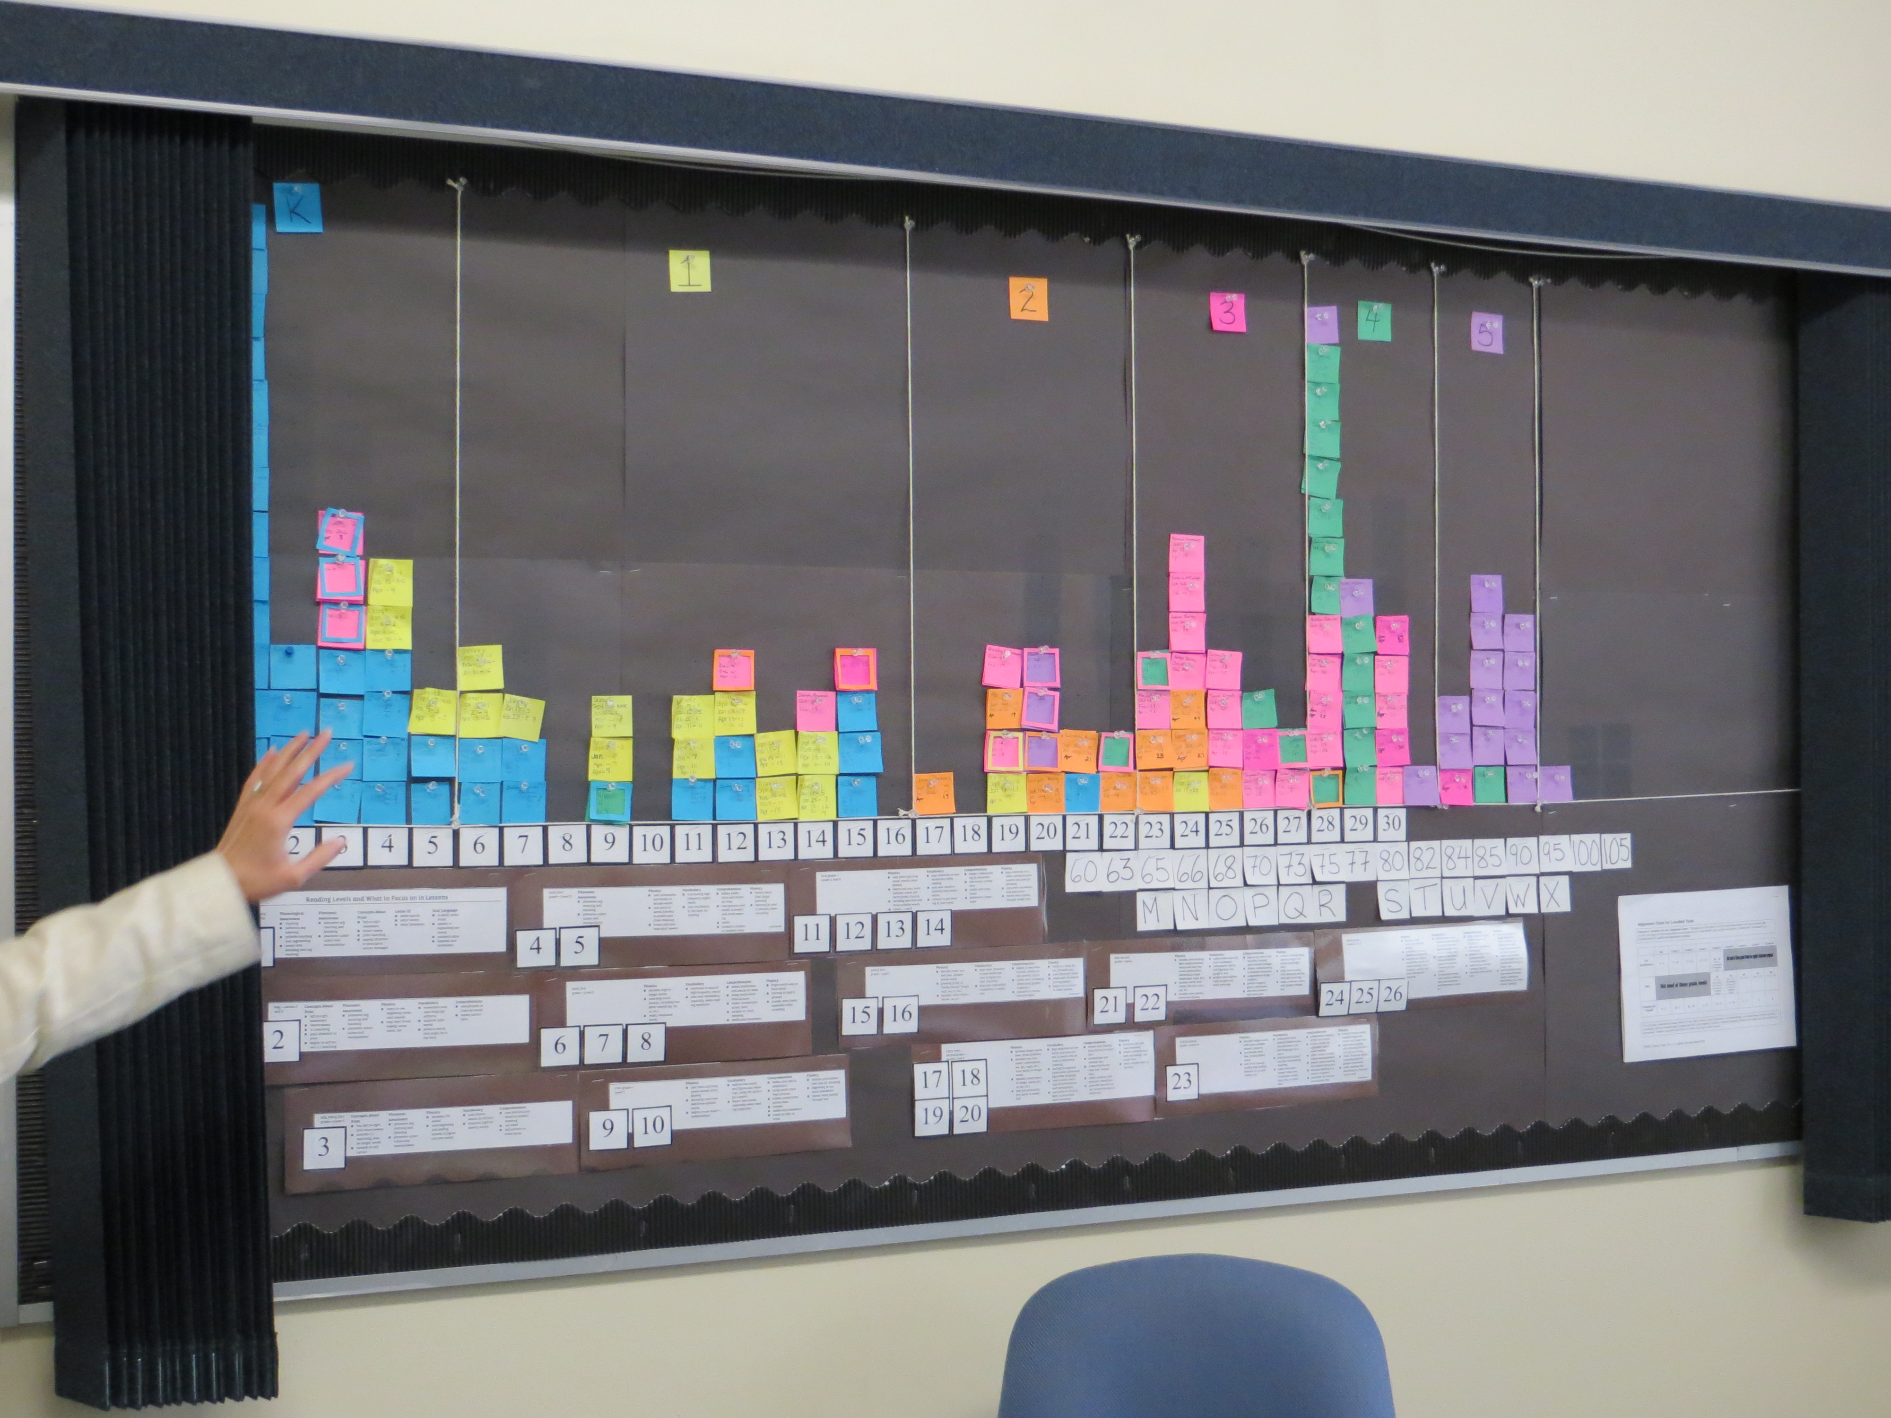
Decisional Capital
…refers to the resources of knowledge, intelligence, and energy that are required to put the human and social capital to effective use.
It is basically the capacity to choose well and make good decisions.

Slide 19
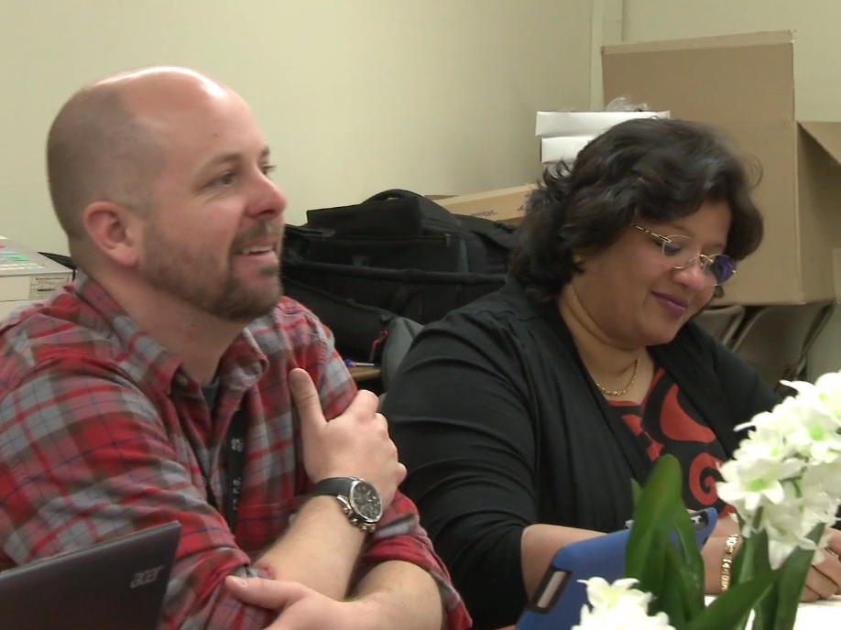
Human vs Social Capital
Team work trumps individual work (do both).
Be careful: focusing on school principal competencies and professional development of teachers is NOT the driver (it is an enabler).
‘Learning is the work’ is the driver, not personnel decisions.

Slide 20
The Lead Learner: The Principal’s New Role
“To increase impact, principals should use their time differently. They should direct their energies to developing the group.”
Fullan pg. 55

Slide 21
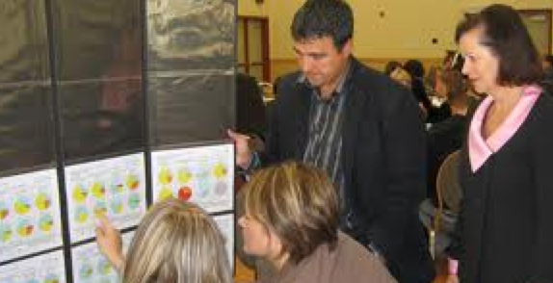
The Principal’s New Role
“…is to lead the school’s teachers in a process of learning to improve their teaching, while learning alongside them about what works and what doesn’t.
Fullan pg. 55

Slide 22
Principal as Lead Learner
“..the principal does not lead all instructional learning. The principal does work to ensure that intense instructional focus and continuous learning are the core work of the school and does this by being a talent scout and social engineer, building a culture for learning, tapping others to co-lead, and, well, basically being a learning leader for all.”
Fullan pg. 90

Slide 23
Stratosphere Defined

Slide 24
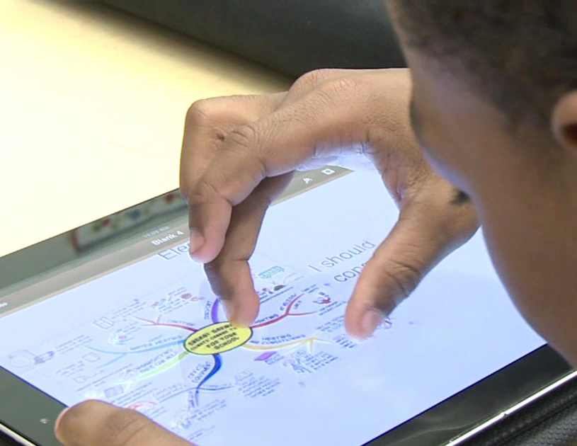
Irresistibly engaging for both students and teachers
Elegantly efficient and easy to use
Technologically ubiquitous 24/7
Steeped in real-life problem solving
NEW
LEARNING
Exciting innovative learning experiences for all students needs to be:

Slide 25
The New Pedagogy
Teachers are needed but it is a new role that is required—the teacher as change agent.

Slide 26
Teachers and Students as Pedagogical Partners
Teacher as Facilitator .17
(simulations and gaming; inquiry based; smaller class sizes; individualized instruction; problem-based learning; web-based; inductive teaching)
Teacher as Activator .60
(reciprocal teaching; feedback; teacher-student self-verbalization; meta-cognition; goals-challenging; frequent effects of teaching)

Slide 27
Principal as Agent of Change
“..the competencies are identifiable and learnable. They will require merging skill and passion in a way that enhances both. They will involve balancing and integrating your assertiveness and other’s initiative.”
Fullan pg. 137

Slide 28
